Slide 1
HIS 103: Emergence of Bangladesh Lecture: 5
Partition of Bengal in 1905: Background, Causes and Consequences
February 15, 2022

Slide 2
Partition of Bengal in 1905
Background of the Partition:
Widespread insurgences throughout Bengal, such as Wahabi Movement, Faraidi Movement, Fakir-Sannyasi revolt, Santal revolt etc.
Impact of the 1857-58 Revolt (Sepoy Mutiny).
Calcutta-based Hindu “Bhadraloks” attempt to launch Bengali nationalist movement- “Swadeshi movement.”
British government’s attempt to bridge relationship with the native people, notably with the Muslims.
Formation of Indian National Congress (1885).
The British Government’s attempted to divide Bengal as a “defensive strategy” (to alleviate the emerging threat posture).

Slide 3
Partition of Bengal in 1905
Reasons behind the 1905 Partition:
The main reasons behind the partition of Bengal:
Administrative reasons;
Political reasons;
(Reflection of the “Divide and Rule” policy of the British);
Socio-economic reasons.
Viceroy Lord Curzon (1899-1905) picked up the partition-plan towards the end of 1903.
Curzon came out soon with a proposal for constituting two provinces: one comprising West Bengal, Bihar and Orissa (to be called Bengal) and the other comprising East Bengal, north Bengal and Assam (to be called East Bengal and Assam), both under lieutenant governors.

Slide 4
Partition of Bengal in 1905
The apparent excuse was administrative convenience- to remove the administrative difficulties to run the vast areas of the Bengal Presidency.
Bengal was “too big to be administered by a single authority efficiently” (An area of nearly 200,000 square miles with a population of roughly 78.5 million).
More efficient administration in the outlying districts of Eastern Bengal and Assam who had been neglected for a long.
But the real reason was to split up the educated and nationalistic Bengalee Hindus and to reduce them to a minority in both the provinces. Therefore, the political and administrative reasons were vital behind the partition of Bengal in 1905.

Slide 5
Partition of Bengal in 1905
The Partition in “Action”!
On September 1, 1905 the much-awaited partition was announced with grave opposition from the Calcutta-based Hindu elites.
The New Province was named “Eastern Bengal and Assam” incorporating Tripura, the divisions of Dhaka, Chittagong, Khulna, Barisal, Sylhet and the districts of Maldha and Assam.
The total land area for the new province was 106,650 square miles with a population of 31 million (of whom Muslims were 18 million, and the Hindus and other community was 13 million).
The Capital of the New Province was Dhaka (then Dacca) with a business Headquarter in Chittagong.
Another Province was the Divided Bengal Presidency, “Bengal” with an area of 141,580 square miles and a population of 54 million, of whom Hindus were 42 million, Muslims 9 million and others 3 million, with its Capital in Calcutta.

Slide 6
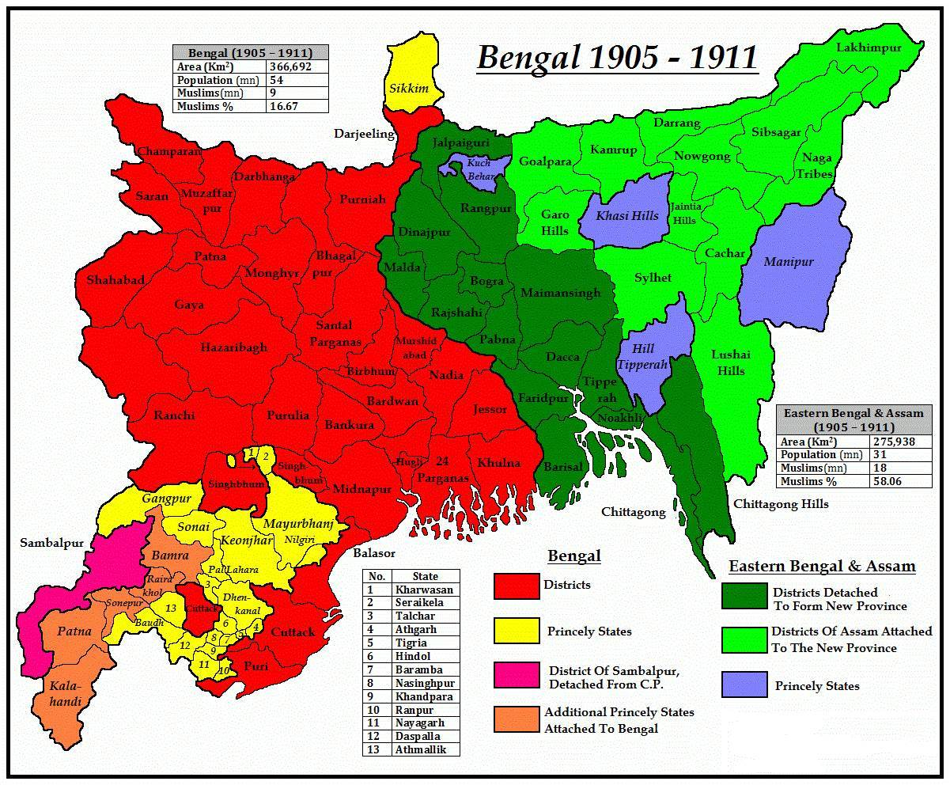
Partition of Bengal in 1905

Slide 7
Partition of Bengal in 1905
Earlier Reactions towards the Partition of Bengal:
Between 7 July and 16 October 1905 when the partition took effect, the whole of Bengal was angry and protesting.
Mammoth protest-meetings were held all over Bengal, for instance, the one at Bagerhat (Khulna) on 16 July 1905 which, for the first time, urged the boycott of all British and foreign goods, the one at the Town Hall in Calcutta on 7 August 1905 presided over by Maharaja Manindra Chandra Nandi of Cossimbazar which called for continued protest and boycott of foreign goods and the one at Barisal B.M. College compound addressed by Ashwini Kumar Datta.
One should note that it was during these months that concepts such as swadeshi or boycott of foreign goods, and en masse resignation from government offices and municipalities, and non-cooperation with colonial rule evolved.
These were to sustain the agitation from 1905 onwards and to be eventually adopted by M.K. Gandhi (later to be known as the ‘Mahatma’).

Slide 8
Partition of Bengal in 1905
Reaction of the Muslims towards the Partition:
Initial Muslim reaction towards the proposal in 1904 was rather dubious, but it sounded good to them.
Surid Shangha (a Dhaka-based cultural organization) welcomed the proposal.
Lord Curzon’s Dhaka visit in January 1904 (as a canvass for the partition) were warmly welcomed by the Muslims. Curzon for the first time exchanged views with the Muslim leaders to win their support in favor of the partition plan.
‘Mohammedan Literary Society’ published a proposal in 1905 expressing a “total support” to the partition plan.
Almost all the Muslim organizations namely Anjuman-I-Mufidul Islam, Faraidi and the Wahabis also supported the proposal.
The foundation of the All Indian Muslim League in 1906 was initially motivated to support the partition.

Slide 9
Partition of Bengal in 1905
Muslim Reactions (contd.)
While Calcutta was fasting and mourning the partition with a strike (hartal), many Muslims in Dhaka were celebrating the partition with prayers of thanksgiving, although there was a shade of sadness at the separation from Calcutta.
Muslim satisfaction was that the partition awarded them a Muslim-majority province, and the ‘East Bengal’ Muslims would be free from the political and economic domination of the Calcutta-based Hindu zamindars, lawyers and businessmen.
Reaction of the Hindu Community:
Calcutta-based Hindu middle class denounced the partition plan terming it the “dissection of motherland.”
To mark their dissent, the Bengali Hindus observed mourning and fasting on October 16, 1905.

Slide 10
Partition of Bengal in 1905
Reaction of the Hindus (contd.)
Swadeshi Movement got new momentum fueling fresh impetus to Hindu nationalism and militancy.
The Bande Mataram (I worship my motherland) slogan inspired the Hindu youths to get involved in anti-partition and ultra-nationalist movement with the use of firearms, pistols and bombs by the youth militants.
The Hindu elites (the educated Hindu community) argued that it was a direct threat to Bengali nationalism, and it would provoke tensions between the Hindus and the Muslims.
They also opined that it was a British attempt to split the “emerging solidarity” of the Bengali-speaking people (both Hindu and Muslim) in Calcutta.

Slide 11
Partition of Bengal in 1905
Reaction of the Indian National Congress:
The Congress dubbed it as an attempt of the British to ‘divide and rule’ the sub-continent.
Moreover, Congress labelled it as “a revengeful treatment towards the Hindu Bhadralok intellectuals” ( Haq, 2019).
In the eye of the Congress, the partition was to “encounter the rapidly growing strength of the educated Hindus and consolidate Muslim power in Eastern Bengal” (Haq, 2019).

Slide 12
Partition of Bengal in 1905
Kabiguru (Rabindranath Tagore) on the Partition of Bengal:
On the day the partition took effect, i.e., 16 October 1905 (30 Aswin 1312 BS) there was fasting and hartal all over Bengal as mentioned before. Kitchens were closed and carriages were off the road.
Rabindranath, who for once participated in active politics, wrote: ‘Bengal is going to be severed by law on 30 Aswin, but God has not separated them. Remembering this and for claiming this we shall observe the day as a day of unity for all Bengalees, and as a token of that, shall tie Rakhis on the wrists of one another, saying brothers shall not separate.’
The direct association of Tagore with the anti-partition and swadeshi movements raised its stature. Rabindranath himself led a procession to the Ganga and initiated a mass ceremony for tying of rakhis on each other’s wrists.
He composed his famous song Banglar mati, Banglar jal, Banglar bayu, Banglar phal especially for this occasion.

Slide 13
Annulment of the Partition of Bengal
Annulment of the Partition of Bengal, 1911:
Because of grave agitation of the Hindu community, rise of communal riots between the Hindus and the Muslims, and increased terrorist assaults against the British, the colonial government dropped the partition plan. On December 12, 1911 King George V at his Coronation Darbar in Delhi announced the termination of the partition.
This greatly hurt the Muslim community. The Bengali Muslims and their leadership took the partition issue as British betrayal towards the community interests.
As a compensation of the annulment of the partition, the British government apparently offered Eastern Bengal with the Dhaka (Dacca) University in the following year (1912) which came into reality in July 1, 1921.

